Slide 2
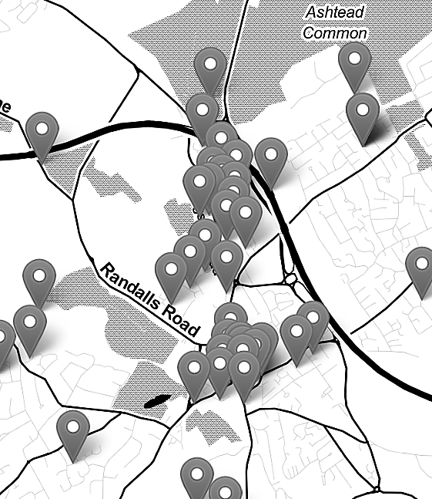

Mapping Crime Data in R
Nadia Kennar, at the UK Data Service (Cathie Marsh Institute)
Copyright © year Institution. Created by Organisation, UK Data Service.

Slide 3
Can you hear us?
?

Slide 4
Troubleshooting audio problems
Check your speaker/headset is plugged in / volume is on.
Click on audio to change to listening via phone
This workshop is live on YouTube. We are also recording this workshop and will post it on YouTube (https://www.youtube.com/user/UKDATASERVICE)

Slide 5
Welcome
All materials today are available here
Github: https://github.com/UKDataServiceOpen/Crime_Data_in_R
(under the Dec_2021 folder)
Real-world example: https://blog.ukdataservice.ac.uk/gis-spatial-data/

Slide 6
Workshop Breakdown
Presentation;
Introduction to GIS and Spatial Data
Code Demo;
Topic 1 – Exploring our crime data
Topic 2 – Shapefiles
Topic 3 – Combining census data (crime rate vs crime count)
Extra Topic – Interactive maps via Leaflet Package

Slide 7
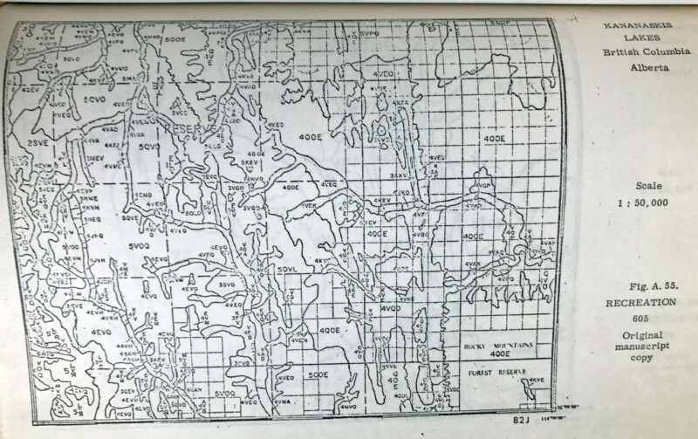
What is GIS?
Graphical Information Systems:
“computer system for capturing, storing, checking, and displaying data related to positions on Earth’s surface”

Slide 8

What software's are available?
GeoDa,
ArcGIS,
FME,
QGIS,
R
…

Slide 9
Reference vs Thematic Maps
Reference Maps: used to communicate location on more static data points
To ‘pin point’ data on a map
Descriptive
Thematic Maps: used to highlight a spatial relationship
To ‘study a theme’ within a map
Explanatory

Slide 10
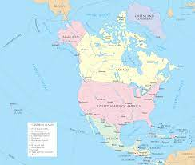
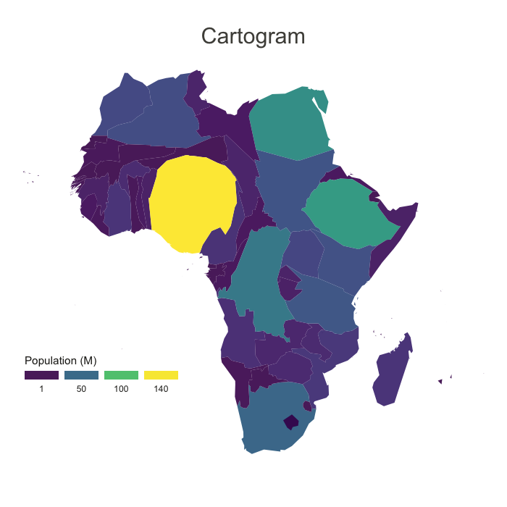
Reference vs Thematic Maps Continued…
Vs

Slide 11
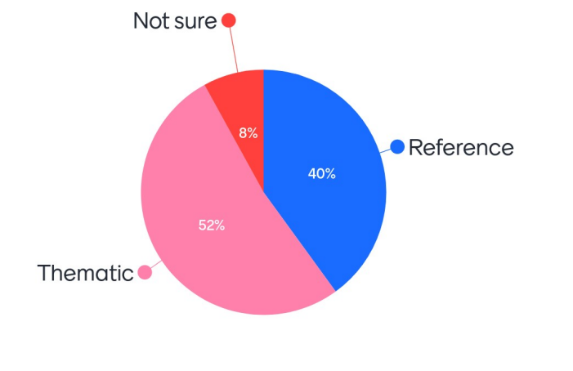
Scenario 1: The visualisation of road networks to improve road safety measures are a type of

Slide 12
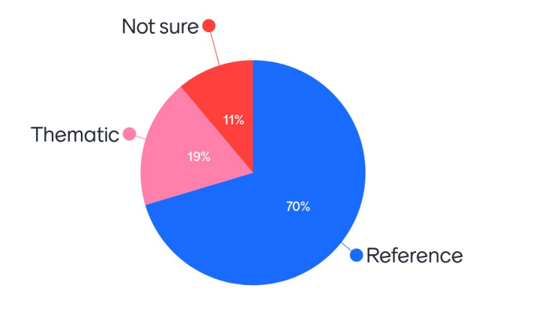
Scenario 2: The visualisation of the earths surface, showing its elevation, is a type of

Slide 13
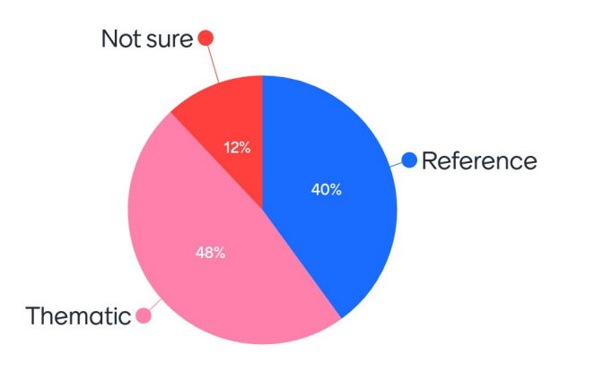
Scenario 3: Navigation tools such as Google maps or City-Mapper can be classed as

Slide 14
Further Example; Tube Maps
How do we class Tube Maps;
Reference maps because…
They show the location of different tube stations, and the location of each tube line
Thematic maps because...
They can be used to predict life expectancy, poverty and median house prices
https://tubecreature.com/#/livesontheline/current/same/U/*/FFTFTF/11.469326848406268/-0.1622/51.5142/

Slide 15
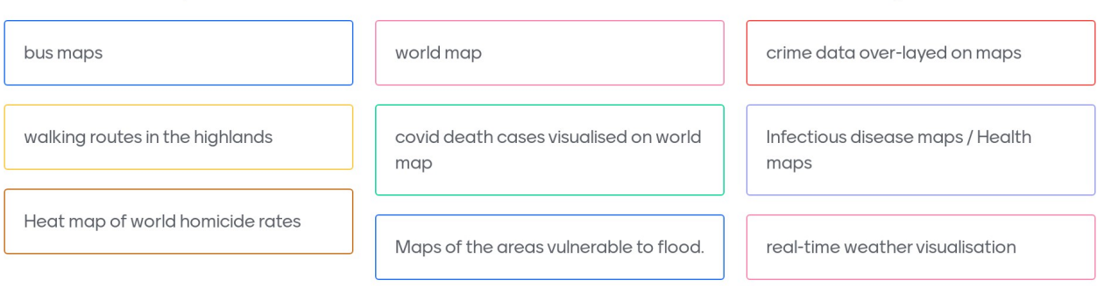
Can you give examples of any other types of map that share qualities of both thematic and reference maps?

Slide 16
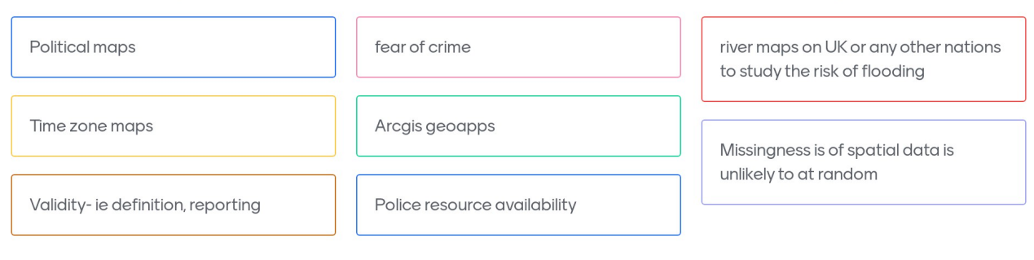
Can you give examples of any other types of map that share qualities of both thematic and reference maps? (continued)

Slide 17
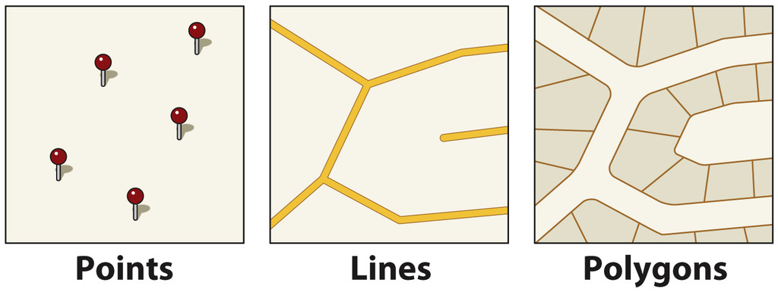
What is Spatial Data?
Vector Data (points, lines and polygons)

Slide 18
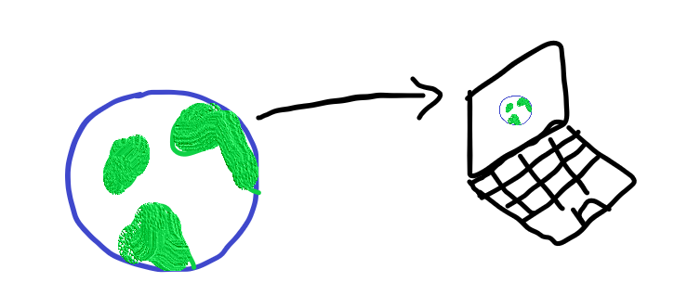
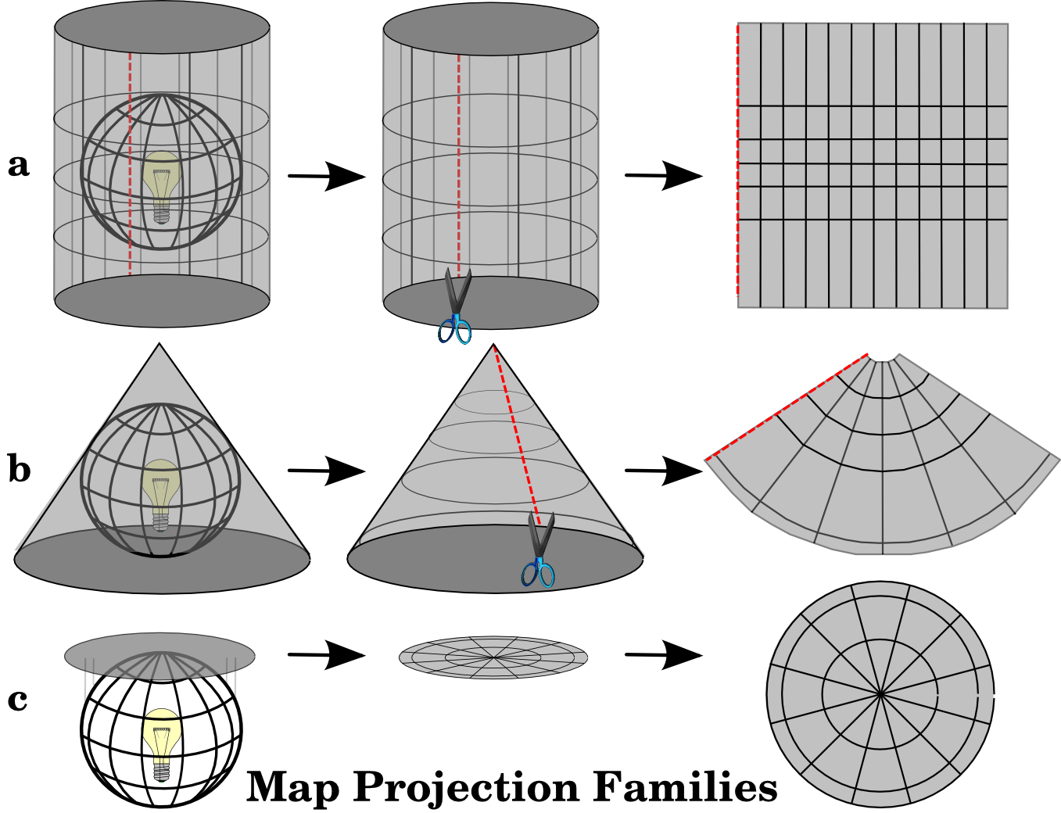
Projection Methods
Moving from the 3D to the 2D
Cylindrical
Conical
Planar

Slide 19
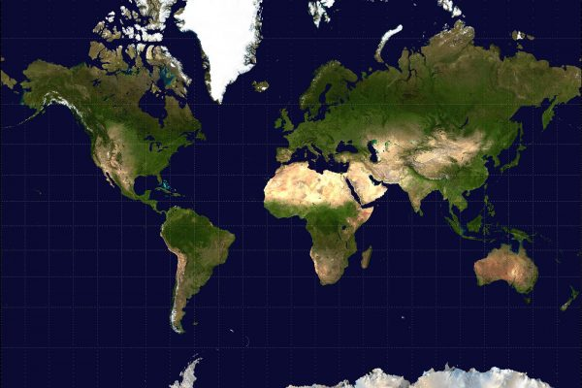
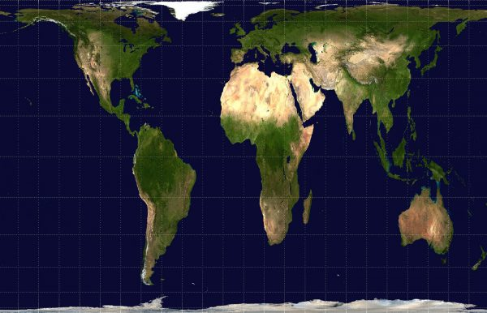
Mercator vs Gall-Peter Projection

Slide 20
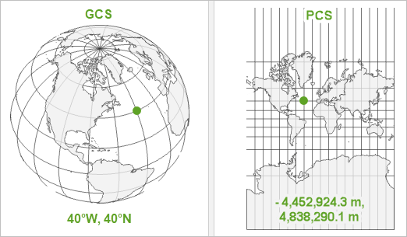
Coordinate Reference Systems (CRS)
The move from the 3D to the 2D is done with the help of CRS
Every place on earth is specified by three numbers (i.e. coordinates)
There are two Main CRS
Geographic Coordinate System vs Projected Coordinate Systems
Notes:
A geographic coordinate system (GCS) is a reference framework that defines the locations of features on a model of the earth. It’s shaped like a globe—spherical. Its units are angular, usually degrees.
A projected coordinate system (PCS) is flat. It contains a GCS, but it converts that GCS into a flat surface, using math (the projection algorithm) and other parameters. Its units are linear, most commonly in meters.
https://www.esri.com/arcgis-blog/products/arcgis-pro/mapping/coordinate-systems-difference/#GCS

Slide 21
What are the main challenges of mapping crime data?
Geomasking and geoprivacy
The accuracy of police recorded statistics
The grey figure of crime
Conceptual issues surrounding its definitions of crime types
The impacts of seasonality; how has Covid-19 affected police recorded crime statistics
Can you think of anymore?

Slide 22
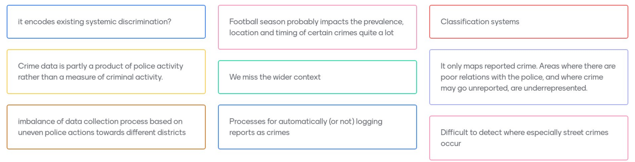
What are the main challenges of mapping crime data?

Slide 23
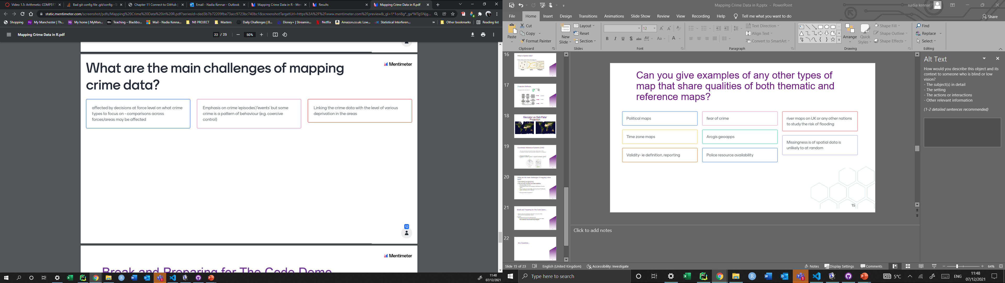
What are the main challenges of mapping crime data? (continued)

Slide 24
Break and Preparing for The Code Demo…
Follow the steps in the ‘Preliminary Tasks.Rmd’ to set up your working directory and to the install packages required
In summary;
Open R Studio and set up your working directory by
Create a new project via version control and copy the repo from github (this will download all code and data onto your computer)

Slide 25
Any Questions…

Slide 26
Thank you.
Email: nadia.kennar@manchester.ac.uk
Twitter: @NadiaKennar

